Slide 1
B V RAJU INSTITUTE OF TECHNOLOGY
(UGC Autonomous)
Vishnupur, Narsapur, Medak District
Department of Computer Science and Engineering
Major Project – Review-III
The Tri-pillar Platform: A Unified System For Academic, Wellness, And Financial Management
By:
22211A0524: A . Yogendra
22211A0523: A . Harshitha
22211A0559: C . Sadwik Reddy
22211A0521: A . Sailaja
Guided By:
Mrs. G. Ahalya Rani
Assistant Professor

Slide 2
Outline
Overview of Reviw-2
Recommendations & Suggestions by panel in Review-2 if any
Proposed Architecture diagram
Proposed List of Modules
Proposed Algorithm /Code Working Steps.
Results in Proposed model/test cases/Screenshots.
Conclusion
References

Slide 3
Overview of Review-2

Slide 4
Recommendations & Suggestions by panel in Review-2.
S.NO | Recommendations & Suggestions given by panel | Changes made by Project Team as per suggestions

Slide 5
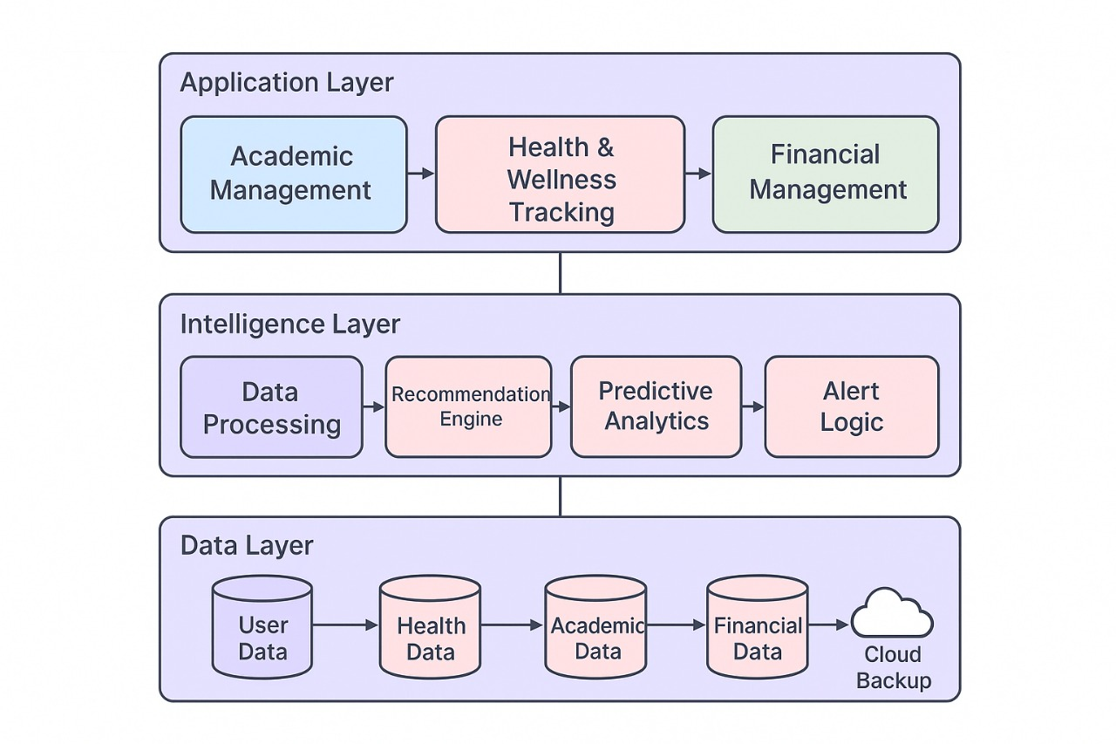
Proposed Architecture diagram

Slide 6
Proposed List of Modules
User Authentication & Profile Management
Academic Planning & Collaboration
Health & Wellness Tracking
Financial Management
Notification & Reminder System
Analytics & Insights
Cloud Integration & Data Security

Slide 7
Proposed Algorithm Explanation/Code Execution
Function ManageAcademicModule(profile): studyPlan = GenerateStudyPlan(profile.academics) peerCollab = SuggestPeerCollaboration(profile.academics) schedule = TrackDeadlinesAndExams(profile.academics) Return {studyPlan, peerCollab, schedule} EndFunction Function GenerateStudyPlan(academics): // AI-based module to create personalized study schedules // Returns optimized study plan EndFunction | Function SuggestPeerCollaboration(academics): // Matches students with peers for group projects or study groups // Returns peer collaboration suggestions EndFunction Function TrackDeadlinesAndExams(academics): // Tracks assignment deadlines and exam schedules // Returns notification-ready data EndFunction
Date:

Slide 8
Proposed Algorithm Explanation/Code Execution
Function ManageAcademicModule(profile): studyPlan = GenerateStudyPlan(profile.academics) peerCollab = SuggestPeerCollaboration(profile.academics) schedule = TrackDeadlinesAndExams(profile.academics) Return {studyPlan, peerCollab, schedule} EndFunction Function GenerateStudyPlan(academics): // AI-based module to create personalized study schedules // Returns optimized study plan EndFunction | Function SuggestPeerCollaboration(academics): // Matches students with peers for group projects or study groups // Returns peer collaboration suggestions EndFunction Function TrackDeadlinesAndExams(academics): // Tracks assignment deadlines and exam schedules // Returns notification-ready data EndFunction
Date:

Slide 9
Proposed Algorithm Explanation/Code Execution
Function TrackHealthWellness(profile): healthLogs = CollectHealthData(profile.health) reminders = GenerateHealthReminders(healthLogs) Return {healthLogs, reminders} EndFunction Function CollectHealthData(health): // Collects stress, mood, and fitness data manually or via apps // Returns structured health log EndFunction | Function GenerateHealthReminders(healthLogs): // Provides reminders for checkups, wellness sessions // Returns list of reminders EndFunction Function ManageFinancialModule(profile): expenses = TrackExpenses(profile.finance) alerts = GeneratePaymentAlerts(profile.finance) suggestions = SuggestFinancialAid(profile.finance) Return {expenses, alerts, suggestions} EndFunction Function TrackExpenses(finance): // Logs income, expenses, and savings // Returns financial summary EndFunction
Date:

Slide 10
Proposed Algorithm Explanation/Code Execution
Function GeneratePaymentAlerts(finance): // Alerts user about due fees, bills, or upcoming payments // Returns alert list EndFunction Function SuggestFinancialAid(finance): // Recommends scholarships, part-time work, or budgeting tips // Returns suggestions list EndFunction Function GenerateNotifications(academicPlan, healthData, financeData): // Combines all reminders and alerts // Returns unified notification list EndFunction | Function GenerateAnalytics(academicPlan, healthData, financeData): // Uses AI to analyze trends across academic, health, and finance // Creates personalized insights dashboard // Returns analytics report EndFunction Function DeployAndMonitorSystem(insights): DeploySystem() MonitorSystemPerformance() DisplayInsights(insights) EndFunction Function DeploySystem(): // Deploys the LifeLink application to the cloud for multi-device access EndFunction
Date:

Slide 11
Proposed Algorithm Explanation/Code Execution
Function MonitorSystemPerformance(): // Tracks uptime, data security, and user engagement // Ensures smooth functioning EndFunction Function DisplayInsights(insights): // Displays recommendations and analytics dashboard to the user EndFunction
Date:

Slide 12
Results in Proposed Model/Test Cases/Screen Shots
Maintain Table format, Comparative analysis should be shown as per the metrics used for validating your proposed algorithm.

Slide 13
Conclusion

Slide 14
References
21K School India. (2025). Predictive Analytics: Enhancing Education Through AI. 21K School India Blog. Retrieved from https://www.21kschool.com/in/blog/predictive-analytics-in-education/
Ghule, V. K., Wakodkar, M., Ulpe, R., Shendurkar, S., & Himpalnerkar, A. (2024). Intelligent Student Support System: An Integrated Platform for Academic, Financial, and Emotional Well-being of Students. International Research Journal of Engineering and Technology (IRJET), 11(12), 295–301.
Aishwaryalakshmi, G., Akash, M., John kingsley, R., & Murali Krishna, R. (2024). Integrated Platform For Student Records And Performance Tracking. International Journal of Creative Research Thoughts (IJCRT), 12(12), g834-g836.
Khirade, R. R., Shetty, B., & Vaidya, M. V. (2024). Hybrid Model to Predict the Performance of Students. International Journal of Engineering Development and Research (IJEDR), 12(1), 1-8
Jaramillo-Alcázar, C. C., Cueva-Morales, J. J., & Pincay-Mora, D. E. (2024). Comparative Analysis of Machine Learning Models for Predicting Student Success in Online Programming Courses: A Study Based on LMS Data and External Factors. Applied Sciences, 14(20), 3272.
Ganesh, S. N. V., Bhuvaneswari, K., Kavipriya, K., Mahalakshmi, S., & Prasanth, G. (2022). Intelligent Recommendation System for Student Career Planning Using Machine Learning. International Journal of Creative Research Thoughts (IJCRT), 10(4), 164–168.
Silva, A. D., de Carvalho, P. P., Costa, D. C. F., dos Santos, S. P., & Ribeiro, J. M. F. (2019). Predictors and Early Warning Systems in Higher Education — A Systematic Literature Review. CEUR Workshop Proceedings, 2415. Retrieved from http://ceur-ws.org/Vol-2415/paper08.pdf
Turkanović, M., Hölbl, M., Košić, K., Heričko, M., & Kamišalić, A. (2018). EduCTX: A Blockchain-Based Higher Education Credit Platform. IEEE Access, 6, 5127–5136.
Good Shepherd Services, Program Evaluation and Planning Department. (2017). LifeLink: Student-Driven College Access and Success.
Papadatou-Pastou, M., Goozee, R., Payne, E., Barrable, A., & Tzotzolis, P. (2017). A review of web-based support systems for students in higher education. International Journal of Mental Health Systems, 11(59).
T. B. R. J. D. L. N. (2017). A Comparative Study to Predict Student's Performance Using Educational Data Mining Techniques. International Journal of Computer Applications, 169(5), 15-20.

Slide 15
Thank You ………..

